Slide 1
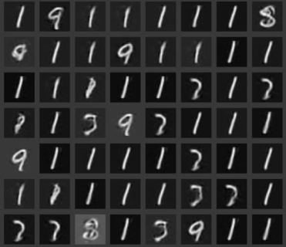
Sparse GANs
Roy Ganz and Tsachi Blau

Slide 2
Table of Contents
Introduction
GANs
Sparse GANs
General idea
Dealing with Mode collapse
Training
Questions

Slide 3
Introduction – GANs
Objective - Neural network model that generates new data
There is generative component denote by G
G is trying to create data that looks real
There is discriminative component denoted by D
D is trying to distinguish the “fake” data from the “real” data

Slide 4
Introduction- SparseLand model
Using a dictionary that fits signals from a certain domain
Every column is an “atom”
Every signal can be represented as a sparse linear combination of atoms
Sparse model is useful in numerous tasks – denoising, compression , etc.

Slide 5
Introduction- Sparse GANs
In this project we are trying to generate new data using SparseLand model
Why do we think it might work better?
The dimensionality of real- images is very large, and its structure is highly complex
Using SparseLand, the Generator task is to generate samples from a simpler distribution

Slide 6
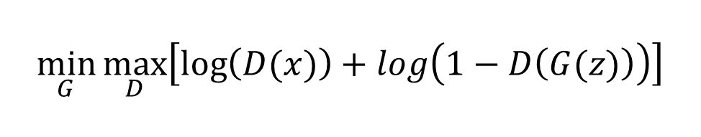
GANs Network
Generator
FC
Discriminator
Noise
Image
Conv
Sigmoid
Original Images
$$\min_{G}{\max_{D}\left[\log\left(D(x)\right)+log\left(1−D\left(G(z)\right)\right)\right]}$$

Slide 7
Sparse GANs Network
Generator
FC
Sparse
Noise
TH
Image
Discriminator
Conv
Sigmoid
Dictionary
Dictionary
Original Images

Slide 8
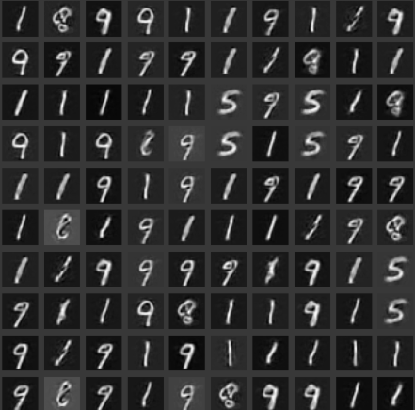
Sparse GANs Results
Lost of 1’s

Slide 9
Sparse GANs Results – discussion
The results are uniform
We get almost only 1’s and 9’s
This phenomenon is called “Mode collapse”

Slide 10
VAE Sparse GANs
VAE
Generator
Sparse
FC
FC
Sparse
Noise
TH
Image
Discriminator
Conv
Sigmoid
Dictionary
Dictionary
Original Images

Slide 11
VAE Sparse GANs – Training (1)
VAE
Generator
Sparse
FC
FC
Sparse
Noise
TH
Image
Discriminator
Conv
Sigmoid
Dictionary
Dictionary
Original Images

Slide 12
VAE Sparse GANs - Training (2)
VAE
Generator
Sparse
FC
FC
Sparse
Noise
TH
Image
Discriminator
Conv
Sigmoid
Dictionary
Dictionary
Original Images

Slide 13
VAE Sparse GANs - Training (3)
VAE
Generator
Sparse
FC
FC
Sparse
Noise
TH
Image
Discriminator
Conv
Sigmoid
Dictionary
Dictionary
Original Images

Slide 14

VAE Sparse GANs – D Loss(1)
Discriminator
Input
Real images
Fake images
Output
“fake”/”real”
Loss
$BCE\left(x\right)=−ylog\left(\hat{y}\right)−\left(1−y\right)log⁡(1−\hat{y})$
Conv
Sigmoid

Slide 15

VAE Sparse GANs – G Loss(2)
Input
Noise
Output
Generated image
Loss
$BCE\left(D\left(Ω∗G\left(z\right)\right),\overline{1}\right)+β∙L_{1}(G(z))$
$β$ controls the sparsity
L1 on the sparse vector
Generator
FC
Sparse
Noise
TH
Image
Dictionary
Dictionary

Slide 16

VAE Sparse GANs – Loss(3)
VAE
Input
Real image
Output
Reconstructed image
Loss
$L_{2}\left(X,\hat{X}\right)+D_{KL}(P, Q)$
Sparse
FC
FC
Sparse
Noise
Image
Real image
Dictionary

Slide 17
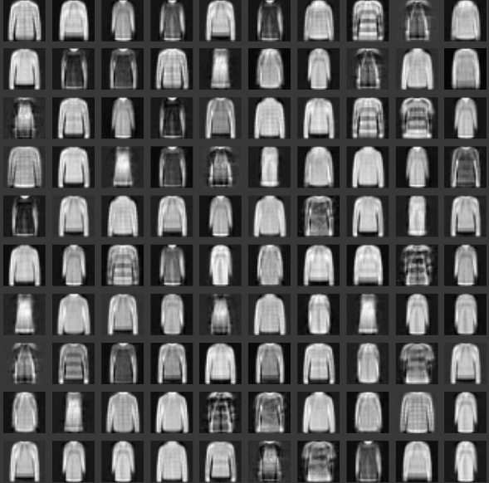
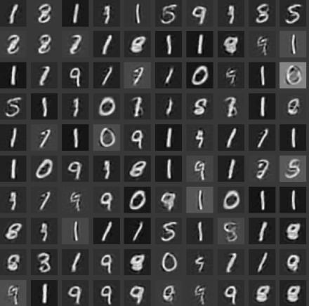
VAE Sparse GANs Results
Fashion MNIST
MNIST

Slide 18
Future work
More complex DATASETs
Tune the noise vector dim
Compare with PCA
Analyze mode collapse by examining the sparse vectors

Slide 19
Question?
Thanks, Roy and Tsachi

